Slide 1
Lecture 8
Hashing

Slide 2
Announcements
HW3 is out! Due Friday.

Slide 3
Girls Teaching Girls to Code is looking for mentors! Announcement:
Girls Teaching Girls to Code is hosting our annual Code Camp, a day-long event during spring quarter that takes place on Stanford's campus and reaches several hundred high school girls. We're looking for Stanford students who are interesting in teaching and mentoring girls interested in computer science for Code Camp.
Check out the application here: http://bit.ly/cc19mentorapp (due by Saturday, February 9th)
Also, check out our info session about Code Camp on Tuesday, February 5th from 4:30-5:30pm at the Women's Community Center. Each person who RSVPs will get free boba!: http://bit.ly/gtgtcinfoandboba

Slide 4
Today: hashing
#
1
NIL
2
22
NIL
3
13
43
NIL
…
9
9
NIL
n=9 buckets

Slide 5
Outline
Hash tables are another sort of data structure that allows fast INSERT/DELETE/SEARCH.
like self-balancing binary trees
The difference is we can get better performance in expectation by using randomness.
Hash families are the magic behind hash tables.
Universal hash families are even more magical.

Slide 6
Goal: Just like last time
We are interesting in putting nodes with keys into a data structure that supports fast INSERT/DELETE/SEARCH.
INSERT
DELETE
SEARCH
node with key “2”
5
2
5
4
4
52
52
data structure
HERE IT IS

Slide 7
Today:
Last time
Self balancing trees:
O(log(n)) deterministic INSERT/DELETE/SEARCH
#prettysweet
Hash tables:
O(1) expected time INSERT/DELETE/SEARCH
Worse worst-case performance, but often great in practice.
#evensweeterinpractice
eg, Python’s dict, Java’s HashSet/HashMap, C++’s unordered_map
Hash tables are used for databases, caching, object representation, …

Slide 8
One way to get O(1) time
This is called “direct addressing”
Say all keys are in the set {1,2,3,4,5,6,7,8,9}.
INSERT:
DELETE:
SEARCH:
9
6
3
5
6
3
2
2 isn’t in the data structure.
3 is here.
3
5
6
9
1
2
3
4
5
6
7
8
9

Slide 9
That should look familiar
Kind of like BUCKETSORT from Lecture 6.
Same problem: if the keys may come from a “universe” U = {1,2, …., 10000000000}….
The universe is really big!

Slide 10
Solution?
Put things in buckets based on one digit
INSERT:
21
345
13
101
50
234
1
1
101
234
345
50
13
21
0
1
2
3
4
5
6
7
8
9
It’s in this bucket somewhere…
go through until we find it.
21
Now SEARCH

Slide 11
Problem…
2
232
INSERT:
52
22
342
12
102
52
232
2
102
12
342
22
0
1
2
3
4
5
6
7
8
9
22
….this hasn’t made our lives easier…
Now SEARCH

Slide 12
Hash tables
That was an example of a hash table.
not a very good one, though.
We will be more clever (and less deterministic) about our bucketing.
This will result in fast (expected time) INSERT/DELETE/SEARCH.

Slide 13
But first! Terminology.
We have a universe U, of size M.
M is really big.
But only a few (say at most n for today’s lecture) elements of M are ever going to show up.
M is waaaayyyyyyy bigger than n.
But we don’t know which ones will show up in advance.
All of the keys in the universe live in this blob.
A few elements are special and will actually show up.
22
Example: U is the set of all strings of at most 140 ascii characters. (128¹⁴⁰ of them).
The only ones which I care about are those which appear as trending hashtags on twitter. #hashinghashtags
There are way fewer than 128¹⁴⁰ of these.
13
Universe U
Examples aside, I’m going to draw elements like I always do, as blue boxes with integers in them…

Slide 14
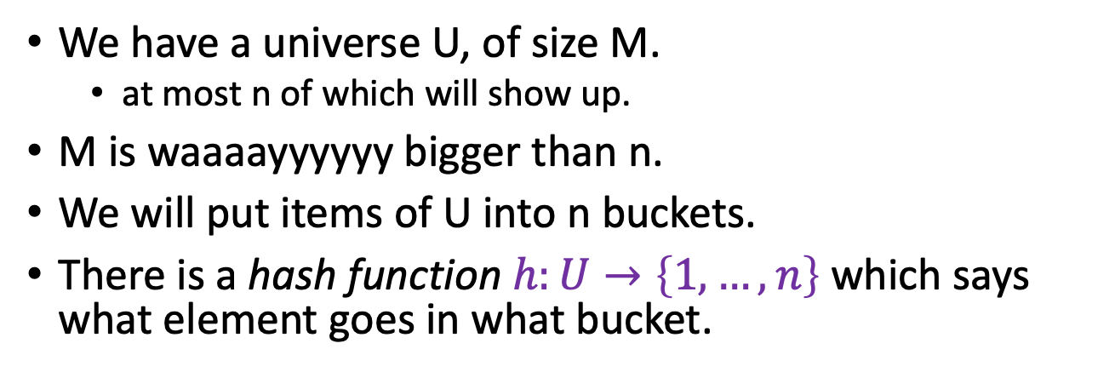
The previous example with this terminology
For this lecture, I’m assuming that the number of things is the same as the number of buckets, both are n.
This doesn’t have to be the case, although we do want:
#buckets = O( #things which show up )
We have a universe U, of size M.
at most n of which will show up.
M is waaaayyyyyy bigger than n.
We will put items of U into n buckets.
There is a hash function $h:U→\left\{1, …, n\right\}$ which says what element goes in what bucket.
All of the keys in the universe live in this blob.
Example:
h(x) = least significant digit of x.
22
1
n buckets
13
2
h(22) = 2
3
h(13) = 3
Universe U

Slide 15
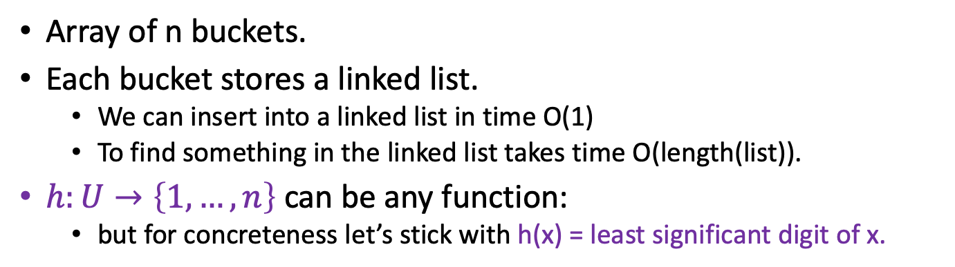
This is a hash table (with chaining)
For demonstration purposes only!
This is a terrible hash function! Don’t use this!
Array of n buckets.
Each bucket stores a linked list.
We can insert into a linked list in time O(1)
To find something in the linked list takes time O(length(list)).
$h:U→\left\{1, …, n\right\}$ can be any function:
but for concreteness let’s stick with h(x) = least significant digit of x.
INSERT:
1
2
22
13
22
43
9
3
13
43
SEARCH 43:
…
Scan through all the elements in bucket h(43) = 3.
9
9
n buckets (say n=9)

Slide 16
Aside: Hash tables with open addressing
The previous slide is about hash tables with chaining.
There’s also something called “open addressing”
Read in CLRS if you are interested!
1
1
2
2
3
13
43
13
3
bounce!
…
43
This is a “chain”
…
9
9
n=9 buckets
n=9 buckets
\end{Aside}

Slide 17
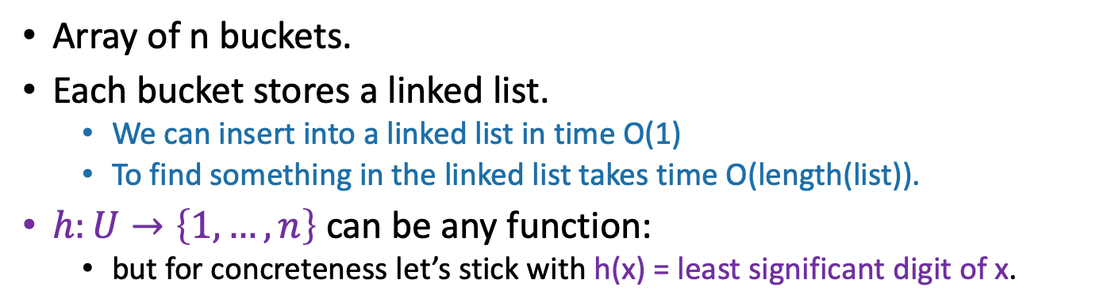
This is a hash table (with chaining)
For demonstration purposes only!
This is a terrible hash function! Don’t use this!
Array of n buckets.
Each bucket stores a linked list.
We can insert into a linked list in time O(1)
To find something in the linked list takes time O(length(list)).
$h:U→\left\{1, …, n\right\}$ can be any function:
but for concreteness let’s stick with h(x) = least significant digit of x.
INSERT:
1
2
22
13
22
43
9
3
13
43
SEARCH 43:
…
Scan through all the elements in bucket h(43) = 3.
9
9
n buckets (say n=9)

Slide 18
Sometimes this a good idea Sometimes this is a bad idea
How do we pick that function so that this is a good idea?
We want there to be not many buckets (say, n).
This means we don’t use too much space
We want the items to be pretty spread-out in the buckets.
This means it will be fast to SEARCH/INSERT/DELETE
93
1
21
vs.
1
3
2
22
2
23
3
13
43
3
13
43
…
…
9
9
9
n=9 buckets
n=9 buckets

Slide 19
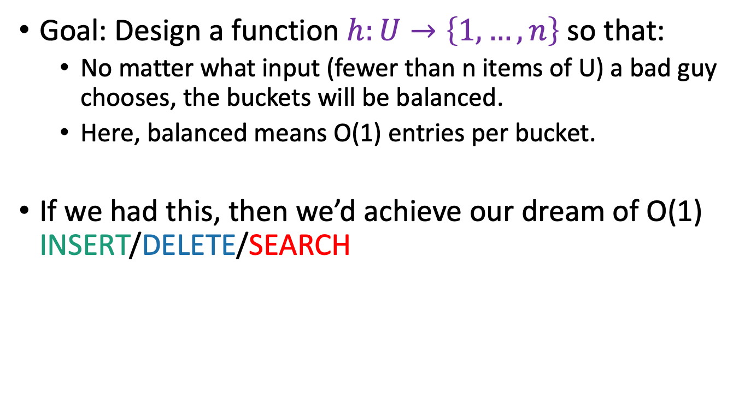
Worst-case analysis
Goal: Design a function $h:U→\left\{1, …, n\right\}$ so that:
No matter what input (fewer than n items of U) a bad guy chooses, the buckets will be balanced.
Here, balanced means O(1) entries per bucket.
If we had this, then we’d achieve our dream of O(1) INSERT/DELETE/SEARCH
Can you come up with such a function?
Think-Pair-Share Terrapins

Slide 20
This is impossible!
93
3
23
13
43
No deterministic hash function can defeat worst-case input!

Slide 21
We really can’t beat the bad guy here.
The universe U has M items
They get hashed into n buckets
At least one bucket has at least M/n items hashed to it.
M is waayyyy bigger then n, so M/n is bigger than n.
Bad guy chooses n of the items that landed in this very full bucket.
.
h(x)
n buckets
These are all the things that hash to the first bucket.
Universe U

Slide 22
Solution: Randomness

Slide 23
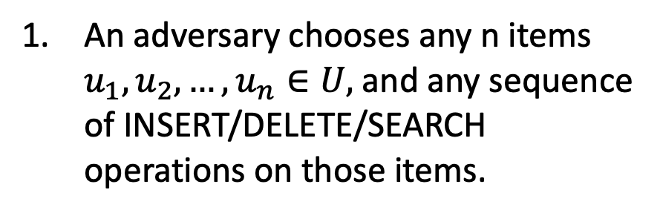
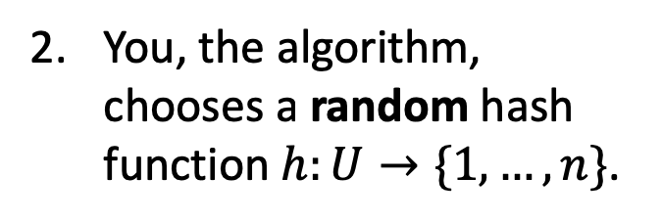
The game
What does random mean here? Uniformly random?
You, the algorithm, chooses a random hash function $h:U→\{1,…,n\}$.
Plucky the pedantic penguin
An adversary chooses any n items $u_{1},u_{2},…, u_{n}∈U,$and any sequence of INSERT/DELETE/SEARCH operations on those items.
HASH IT OUT
#hashpuns
13
22
43
92
7
1
43
INSERT 13, INSERT 22, INSERT 43, INSERT 92, INSERT 7, SEARCH 43, DELETE 92, SEARCH 7, INSERT 92
22
2
3
13
u_{j}
…
u_{k}
7
u_{i}
n
92

Slide 24
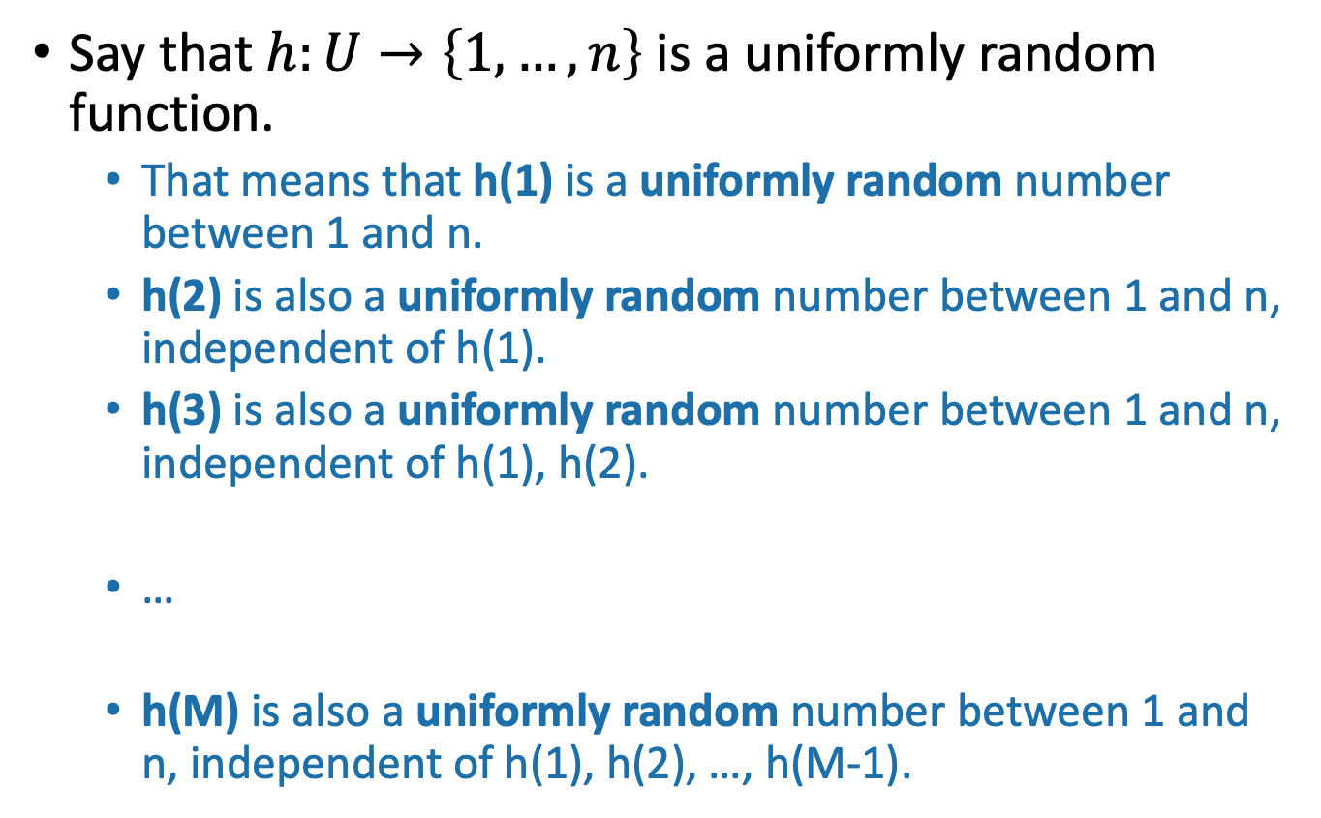
Example
Universe U
h
n buckets
Say that $h:U→\left\{1,…,n\right\}$ is a uniformly random function.
That means that h(1) is a uniformly random number between 1 and n.
h(2) is also a uniformly random number between 1 and n, independent of h(1).
h(3) is also a uniformly random number between 1 and n, independent of h(1), h(2).
…
h(M) is also a uniformly random number between 1 and n, independent of h(1), h(2), …, h(M-1).

Slide 25
Randomness helps
Intuitively: The bad guy can’t foil a hash function that he doesn’t yet know.
Lucky the Lackadaisical Lemur
Why not? What if there’s some strategy that foils a random function with high probability?
Plucky the Pedantic Penguin
We’ll need to do some analysis…

Slide 26
What do we want?
It’s bad if lots of items land in u_{i}’s bucket.
So we want not that.
1
43
2
22
3
14
7
u_{i}
32
5
15
…
n
92
8

Slide 27
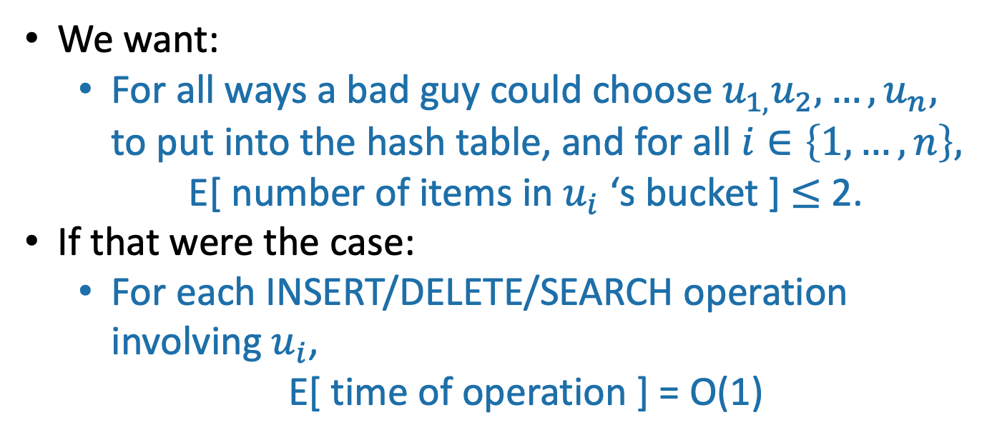

More precisely
We could replace “2” here with any constant; it would still be good. But “2” will be convenient.
We want:
For all ways a bad guy could choose $u_{1,}u_{2},…, u_{n},$ to put into the hash table, and for all $i∈\left\{1, …, n\right\},$
E[ number of items in $u_{i}$ ‘s bucket ] $≤$ 2.
If that were the case:
For each INSERT/DELETE/SEARCH operation involving $u_{i}$,
E[ time of operation ] = O(1)
1
43
2
22
3
14
$$u_{i}$$
This is what we wanted at the beginning of lecture!
…
n
92
8

Slide 28
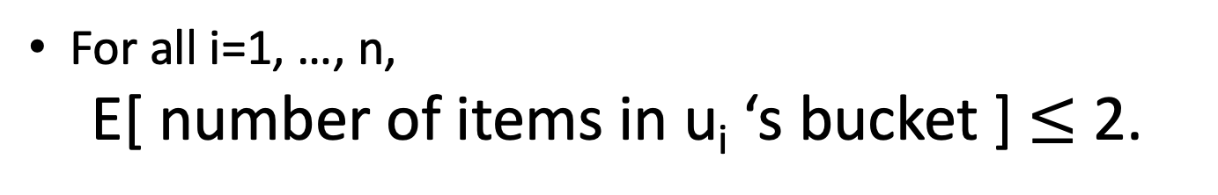
So we want:
For all i=1, …, n,
E[ number of items in u_{i} ‘s bucket ] $≤$ 2.

Slide 29
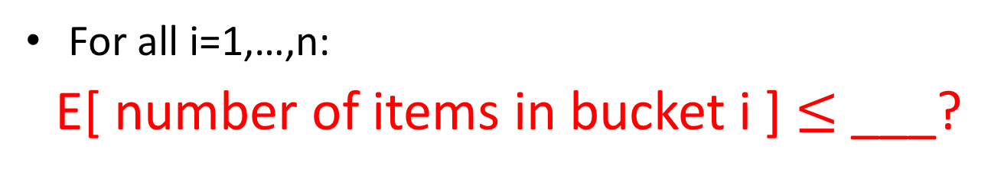
Aside: why not:
This slide skipped in class
For all i=1,…,n:
E[ number of items in bucket i ] $≤$ ___?
Suppose that:
43
14
22
92
8
1
this happens with probability 1/n
2
1
3
2
43
14
22
92
8
…
and this happens with probability 1/n
3
n
etc.
…
Then E[ number of items in bucket i ] = 1 for all i.
But P{ the buckets get big } = 1.
n

Slide 30

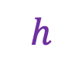



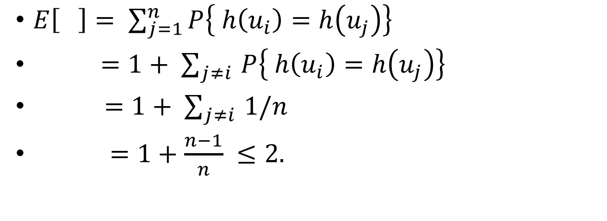


Expected number of items in $u_{i}$’s bucket?
h is uniformly random
$E\left[ \right]= \sum_{j=1}^{n}{P\left\{ h\left(u_{i}\right)=h\left(u_{j}\right)\right\}}$
$=1+ \sum_{j≠i }{P\left\{ h\left(u_{i}\right)=h\left(u_{j}\right)\right\}}$
$=1+ \sum_{j≠i }{1/n}$
$=1+\frac{n−1}{n} ≤2.$
(You will verify this on HW.)
That’s what we wanted!
Universe U
$$h$$
$$u_{k}$$
$$u_{i}$$
n buckets
$$u_{j}$$
$$u_{i}$$
$$u_{j}$$
COLLISION!

Slide 31
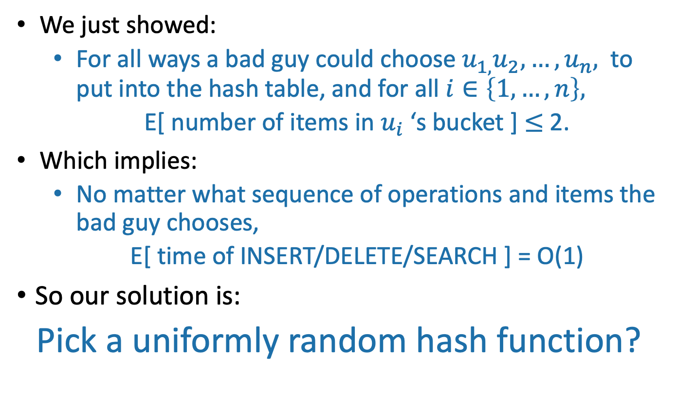
That’s great!
We just showed:
For all ways a bad guy could choose $u_{1,}u_{2},…, u_{n},$ to put into the hash table, and for all $i∈\left\{1, …, n\right\},$
E[ number of items in $u_{i}$ ‘s bucket ] $≤$ 2.
Which implies:
No matter what sequence of operations and items the bad guy chooses,
E[ time of INSERT/DELETE/SEARCH ] = O(1)
So our solution is:
Pick a uniformly random hash function?

Slide 32
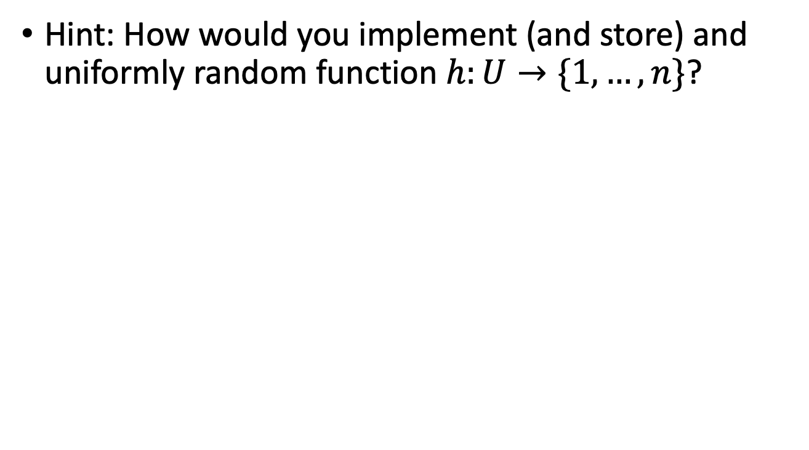
What’s wrong with this plan?
Hint: How would you implement (and store) and uniformly random function $h:U→\{1,…,n\}$?
If h is a uniformly random function:
That means that h(1) is a uniformly random number between 1 and n.
h(2) is also a uniformly random number between 1 and n, independent of h(1).
h(3) is also a uniformly random number between 1 and n, independent of h(1), h(2).
…
h(n) is also a uniformly random number between 1 and n, independent of h(1), h(2), …, h(n-1).
Think-Pair-Share Terrapins

Slide 33
A uniformly random hash function is not a good idea.
In order to store/evaluate a uniformly random hash function, we’d use a lookup table:
x | h(x)
AAAAAA | 1
AAAAAB | 5
AAAAAC | 3
AAAAAD | 3
…
ZZZZZY | 7
ZZZZZZ | 3
Each value of h(x) takes log(n) bits to store.
Storing M such values requires Mlog(n) bits.
In contrast, direct addressing (initializing a bucket for every item in the universe) requires only M bits….
All of the M things in the universe

Slide 34
Another thought…
THIS SLIDE SKIPPED IN CLASS
Just remember h on the relevant values
h(7) = 8
13
h(43) = 2
h(92) = 3
43
7
22
92
h(22) = 3
h(13) = 6
h(13) = 6
We need some way of storing keys and values with O(1) INSERT/DELETE/SEARCH…
h(22) = 3
Algorithm now
Algorithm later

Slide 35
Could we store a uniformly random h without using a lookup table?
Maybe there’s a different way to store h that uses less space?

Slide 36
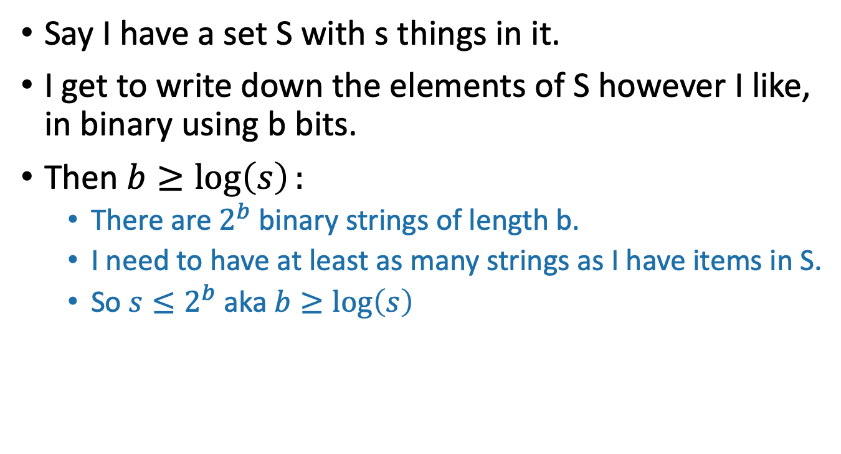
Aside: description length
Say I have a set S with s things in it.
I get to write down the elements of S however I like, in binary using b bits.
Then $b≥\log\left(s\right):$
There are $2^{b}$ binary strings of length b.
I need to have at least as many strings as I have items in S.
So $s≤2^{b}$ aka $b≥\log\left(s\right)$
S
I’ll call this one “Fido”
This one is named “Hercules”
Or, 011011
Or, 101111

Slide 37
We need Mlog(n) bits to store a random hash function h:U -> {1,…,n}
Say that this elephant-shaped blob represents the set of all hash functions.
It has size n^{M}. (Really big!)
To write down a random hash function, we need log(n^{M}) = Mlog(n) bits.
A random hash function is just a random element in this set.
All of the hash functions
h:U →{1,…,n}
Technically we should argue that we need at least Mlog(n) bits on average when we draw a random hash function… why can’t one item have a really long name and others have shorter names?

Slide 38
Solution
Pick from a smaller set of functions.
A cleverly chosen subset of functions. We call such a subset a hash family.
All of the hash functions h:U →{1,…,n}
H
We need only log|H| bits to store an element of H.

Slide 39
Outline
Hash tables are another sort of data structure that allows fast INSERT/DELETE/SEARCH.
like self-balancing binary trees
The difference is we can get better performance in expectation by using randomness.
Hash families are the magic behind hash tables.
Universal hash families are even more magic.

Slide 40
Hash families
A hash family is a collection of hash functions.
All of the hash functions h:U →{1,…,n}
”All of the hash functions” is an example of a hash family.

Slide 41
Example: a smaller hash family
This is still a terrible idea! Don’t use this example!
For pedagogical purposes only!
H = { function which returns the least sig. digit,
function which returns the most sig. digit }
Pick h in H at random.
Store just one bit to remember which we picked.
All of the hash functions h:U →{1,…,n}
H

Slide 42
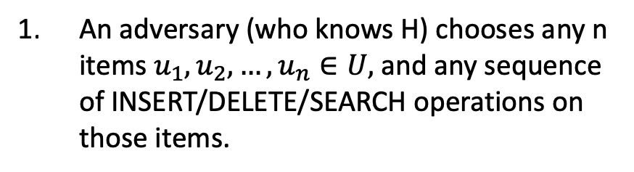
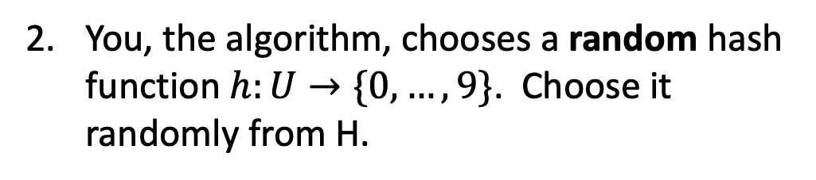
The game
You, the algorithm, chooses a random hash function $h:U→\{0,…, 9\}$. Choose it randomly from H.
h₀ = Most_significant_digit
h₁ = Least_significant_digit
H = {h₀, h₁}
I picked h₁
An adversary (who knows H) chooses any n items $u_{1},u_{2},…, u_{n}∈U,$and any sequence of INSERT/DELETE/SEARCH operations on those items.
HASH IT OUT
#hashpuns
19
22
42
92
0
0
0
INSERT 19, INSERT 22, INSERT 42, INSERT 92, INSERT 0, SEARCH 42, DELETE 92, SEARCH 0, INSERT 92
1
22
42
92
2
u_{j}
…
u_{k}
19
u_{i}
9

Slide 43
This is not a very good hash family
H = { function which returns least sig. digit,
function which returns most sig. digit }
On the previous slide, the adversary could have been a lot more adversarial…

Slide 44
The game
You, the algorithm, chooses a random hash function $h:U→\{0,…, 9\}$. Choose it randomly from H.
h₀ = Most_significant_digit
h₁ = Least_significant_digit
H = {h₀, h₁}
I picked h₁
An adversary (who knows H) chooses any n items $u_{1},u_{2},…, u_{n}∈U,$and any sequence of INSERT/DELETE/SEARCH operations on those items.
HASH IT OUT
#hashpuns
101
11
121
141
131
0
1
11
101
2
141
u_{j}
121
…
u_{k}
u_{i}
9
131

Slide 45
Outline
Hash tables are another sort of data structure that allows fast INSERT/DELETE/SEARCH.
like self-balancing binary trees
The difference is we can get better performance in expectation by using randomness.
Hash families are the magic behind hash tables.
Universal hash families are even more magic.

Slide 46
How to pick the hash family?
Definitely not like in that example.
Let’s go back to that computation from earlier….
H

Slide 47
Expected number of items in u_{i}’s bucket?
$E\left[ \right]= \sum_{j=1}^{n}{P\left\{ h\left(u_{i}\right)=h\left(u_{j}\right)\right\}}$
$=1+ \sum_{j≠i }{P\left\{ h\left(u_{i}\right)=h\left(u_{j}\right)\right\}}$
$=1+ \sum_{j≠i }{1/n}$
$=1+\frac{n−1}{n} ≤2.$
All that we needed was that this is 1/n
Universe U
h
u_{k}
u_{i}
n buckets
u_{j}
u_{i}
u_{j}
COLLISION!

Slide 48
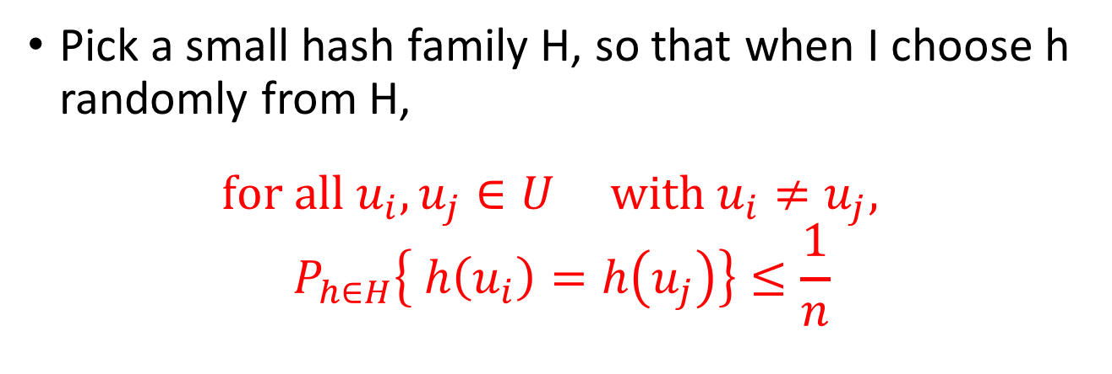
Strategy
Pick a small hash family H, so that when I choose h randomly from H,
$$for all u_{i}, u_{j}∈U with u_{i}≠u_{j},$$
$$P_{h∈H}\left\{ h\left(u_{i}\right)=h\left(u_{j}\right)\right\}≤\frac{1}{n}$$
In English: fix any two elements of U. The probability that they collide under a random h in H is small.
A hash family H that satisfies this is called a universal hash family.
Then we still get O(1)-sized buckets in expectation.
But now the space we need is log(|H|) bits.
Hopefully pretty small!
h
H

Slide 49
So the whole scheme will be
Choose h randomly from a universal hash family H
We can store h in small space since H is so small.
u₁
u_{k}
Probably these buckets will be pretty balanced.
u_{i}
u_{j}
h
n buckets
u_{i}
Universe U

Slide 50
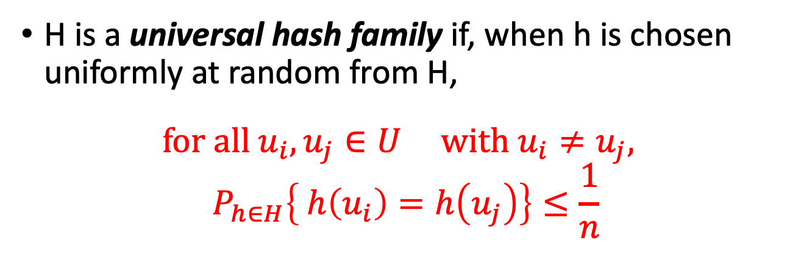
Universal hash family
H is a universal hash family if, when h is chosen uniformly at random from H,
$$for all u_{i}, u_{j}∈U with u_{i}≠u_{j},$$
$$P_{h∈H}\left\{ h\left(u_{i}\right)=h\left(u_{j}\right)\right\}≤\frac{1}{n}$$

Slide 51
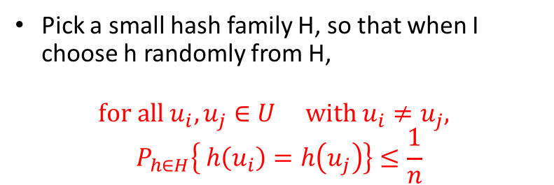
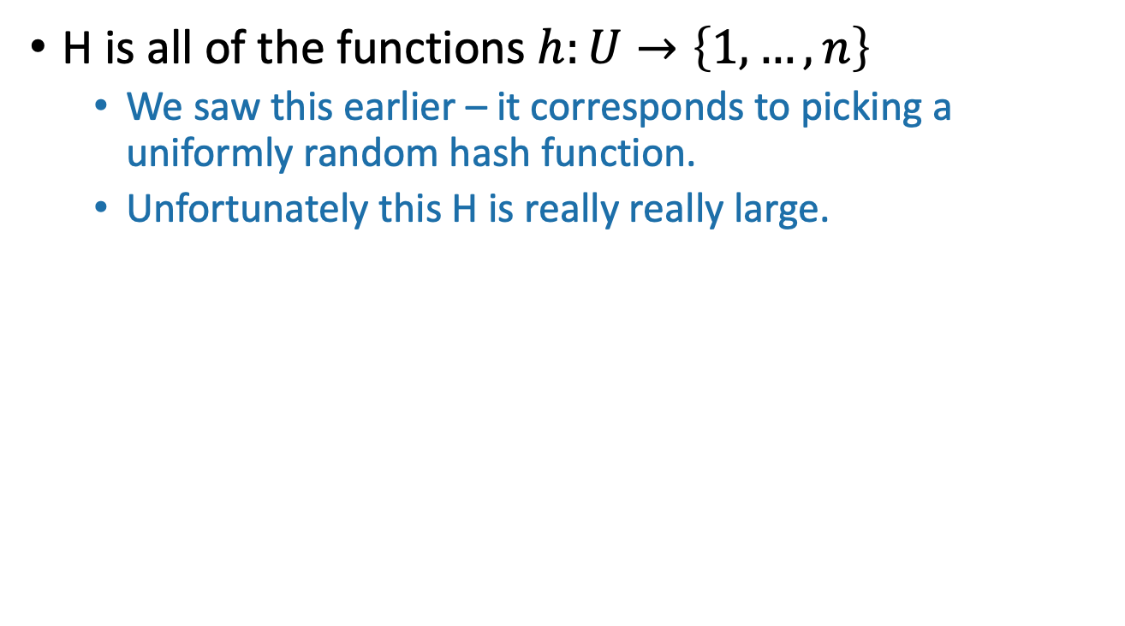
Example
Pick a small hash family H, so that when I choose h randomly from H,
$$for all u_{i}, u_{j}∈U with u_{i}≠u_{j},$$
$$P_{h∈H}\left\{ h\left(u_{i}\right)=h\left(u_{j}\right)\right\}≤\frac{1}{n}$$
H is all of the functions $h:U→\left\{1,…,n\right\}$
We saw this earlier – it corresponds to picking a uniformly random hash function.
Unfortunately this H is really really large.

Slide 52
Non-example
Pick a small hash family H, so that when I choose h randomly from H,
$$for all u_{i}, u_{j}∈U with u_{i}≠u_{j},$$
$$P_{h∈H}\left\{ h\left(u_{i}\right)=h\left(u_{j}\right)\right\}≤\frac{1}{n}$$
h₀ = Most_significant_digit
h₁ = Least_significant_digit
H = {h₀, h₁}
Prove that this choice of H is NOT a universal hash family!

Slide 53
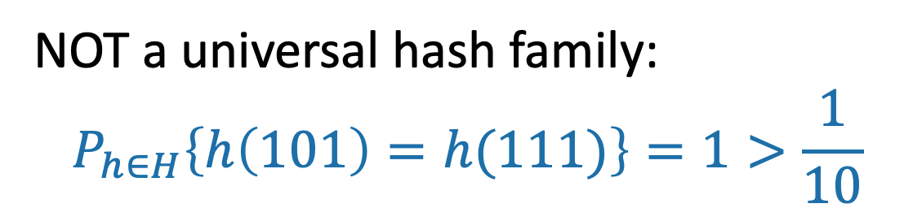
Non-example
Pick a small hash family H, so that when I choose h randomly from H,
$$for all u_{i}, u_{j}∈U with u_{i}≠u_{j},$$
$$P_{h∈H}\left\{ h\left(u_{i}\right)=h\left(u_{j}\right)\right\}≤\frac{1}{n}$$
h₀ = Most_significant_digit
h₁ = Least_significant_digit
H = {h₀, h₁}
NOT a universal hash family:
$$P_{h∈H}\left\{h\left(101\right)=h(111)\right\}=1>\frac{1}{10}$$

Slide 54
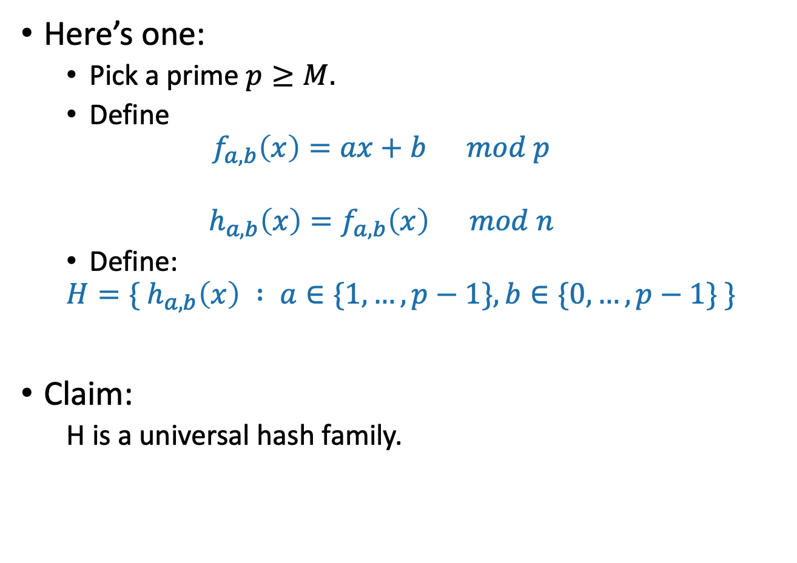
A small universal hash family??
Here’s one:
Pick a prime $p≥M.$
Define
$$f_{a,b}\left(x\right)=ax+b mod p$$
$$h_{a,b}\left(x\right)=f_{a,b}\left(x\right) mod n$$
Define:
$$H=\{ h_{a,b}\left(x\right) : a∈\{1,…, p−1\}, b∈\{0, …, p−1\} \}$$
Claim:
H is a universal hash family.
??

Slide 55
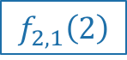
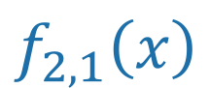
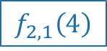
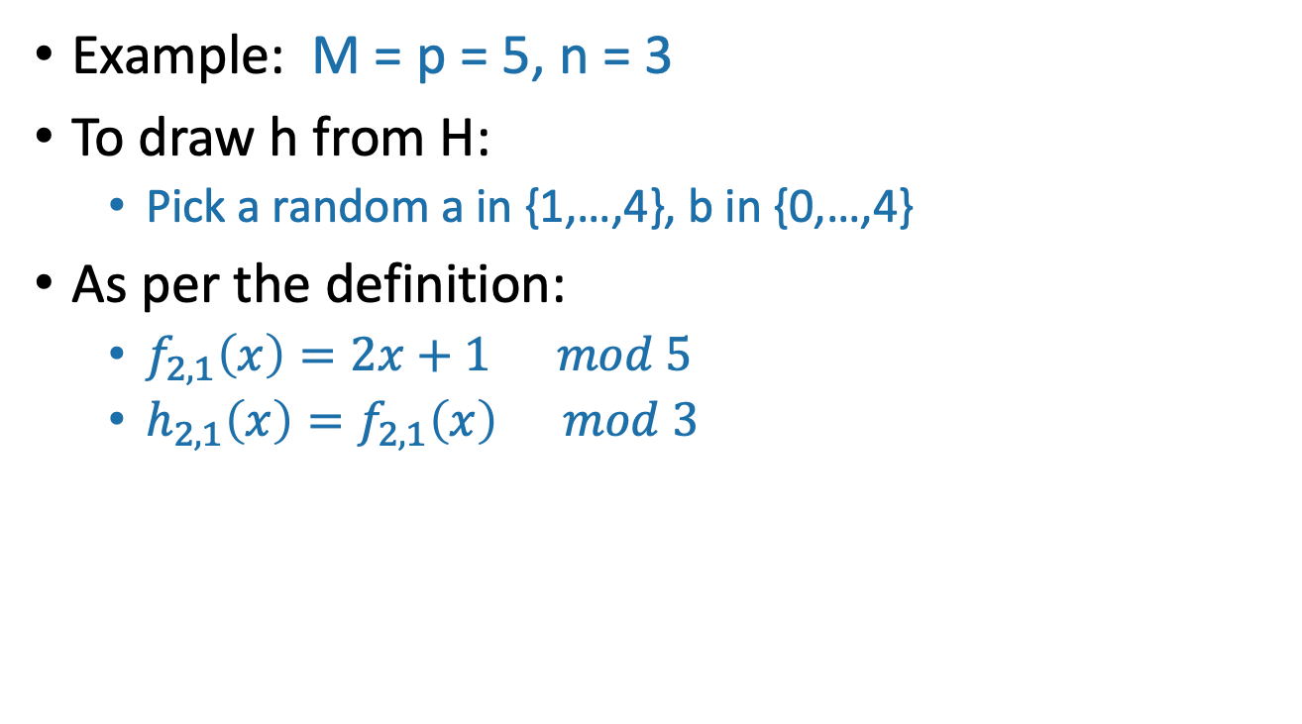
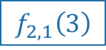
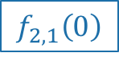
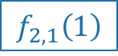
Say what?
1,2,3,4,5
a = 2, b = 1
Example: M = p = 5, n = 3
To draw h from H:
Pick a random a in {1,…,4}, b in {0,…,4}
As per the definition:
$f_{2,1}\left(x\right)=2x+1 mod 5$
$h_{2,1}\left(x\right)=f_{2,1}\left(x\right) mod 3$
$$f_{2,1}\left(3\right)$$
1
$$f_{2,1}\left(1\right)$$
2
3
$$f_{2,1}\left(x\right)$$
3
2
1
mod 3
2
4
1
$$f_{2,1}\left(0\right)$$
0
4
0
$$f_{2,1}\left(4\right)$$
3
U =
This step just scrambles stuff up. No collisions here!
$$f_{2,1}\left(2\right)$$
This step is the one where two different elements might collide.

Slide 56
Ignoring why this is a good idea
Can we store h with small space?
Just need to store two numbers:
a is in {1,…,p-1}
b is in {0,…,p-1}
So about 2log(p) bits
By our choice of p, that’s O(log(M)) bits.
1,2,3,4,5
a = 2, b = 1
Compare: direct addressing was M bits!
Twitter example: log(M) = 140 log(128) = 980 vs M = 128¹⁴⁰

Slide 57
Another way to see that We only need log(M) bits to store h
We have p-1 choices for a, and p choices for b.
So |H| = p(p-1) = O(M²)
Space needed to store an element h:
log(M²) = O(log(M)).
O(M log(n)) bits
per function
O(log(M)) bits
per function
Notes:
Notice that the functions in the small set H also belong to the big elephant set. But we describe them differently if we know that they come from the small set.

Slide 58
Why does this work?
This is actually a little complicated.
See CLRS (Thm 11.5) if you are curious.
You are NOT RESPONSIBLE for the proof in this class.
But you should know that a universal hash family of size O(M²) exists.
Try to prove that this is a universal hash family!

Slide 59
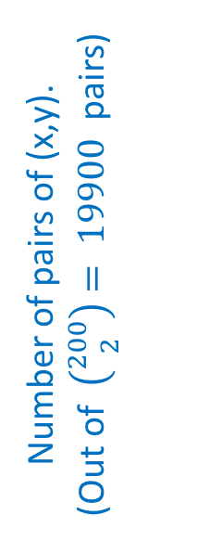
But let’s check that it does work
Check out the IPython notebook for lecture 8
M=200, n=10
Number of pairs of (x,y).
(Out of $\left({200 \atop 2}\right)= 19900$pairs)
Empirical probability of collision out of 100 trials

Slide 60
So the whole scheme will be
Choose a and b at random and form the function h_{a,b}
We can store h in space O(log(M)) since we just need to store a and b.
u₁
u_{k}
Probably these buckets will be pretty balanced.
u_{i}
u_{j}
h_{a,b}
n buckets
u_{i}
Universe U

Slide 61
Outline
Hash tables are another sort of data structure that allows fast INSERT/DELETE/SEARCH.
like self-balancing binary trees
The difference is we can get better performance in expectation by using randomness.
Hash families are the magic behind hash tables.
Universal hash families are even more magic.
Recap

Slide 62
Want O(1) INSERT/DELETE/SEARCH
We are interesting in putting nodes with keys into a data structure that supports fast INSERT/DELETE/SEARCH.
INSERT
DELETE
SEARCH
5
2
5
4
4
52
52
data structure
HERE IT IS

Slide 63
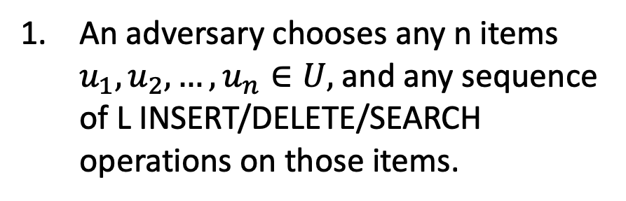
We studied this game
You, the algorithm, chooses a random hash function $h:U→\{1,…,n\}$.
An adversary chooses any n items $u_{1},u_{2},…, u_{n}∈U,$and any sequence of L INSERT/DELETE/SEARCH operations on those items.
HASH IT OUT
13
22
43
92
7
1
43
INSERT 13, INSERT 22, INSERT 43, INSERT 92, INSERT 7, SEARCH 43, DELETE 92, SEARCH 7, INSERT 92
22
2
3
13
u_{j}
…
u_{k}
7
u_{i}
n
92

Slide 64
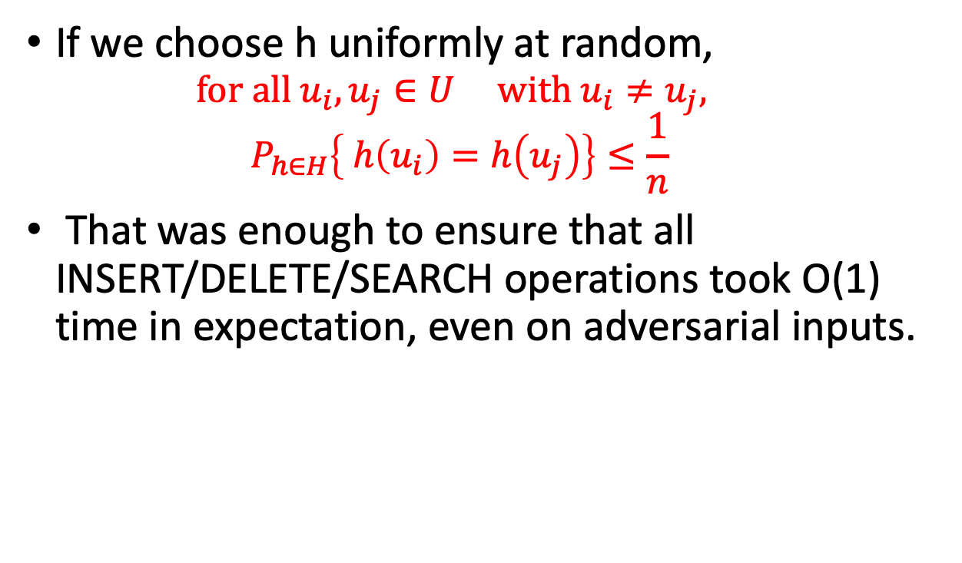
Uniformly random h was good
If we choose h uniformly at random,
$$for all u_{i}, u_{j}∈U with u_{i}≠u_{j},$$
$$P_{h∈H}\left\{ h\left(u_{i}\right)=h\left(u_{j}\right)\right\}≤\frac{1}{n}$$
That was enough to ensure that all INSERT/DELETE/SEARCH operations took O(1) time in expectation, even on adversarial inputs.

Slide 65
Uniformly random h was bad
If we actually want to implement this, we have to store the hash function h.
That takes a lot of space!
We may as well have just initialized a bucket for every single item in U.
All of the hash functions h:U →{1,…,n}
Instead, we chose a function randomly from a smaller set.

Slide 66
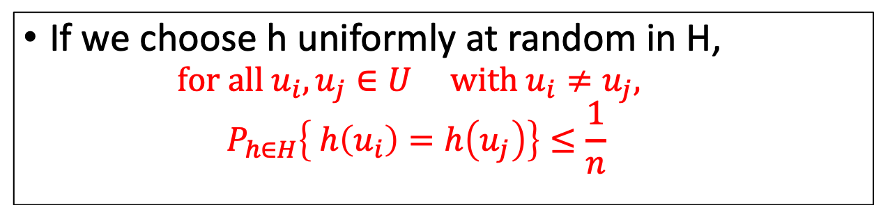
We needed a smaller set that still has this property
If we choose h uniformly at random in H,
$$for all u_{i}, u_{j}∈U with u_{i}≠u_{j},$$
$$P_{h∈H}\left\{ h\left(u_{i}\right)=h\left(u_{j}\right)\right\}≤\frac{1}{n}$$
This was all we needed to make sure that the buckets were balanced in expectation!
We call any set with that property a
universal hash family.
We gave an example of a really small one ☺

Slide 67
Conclusion:
Hashing a universe of size M into n buckets, where at most n of the items in M ever show up.
We can build a hash table that supports INSERT/DELETE/SEARCH in O(1) expected time
Requires O(n log(M)) bits of space.
O(n) buckets
O(n) items with log(M) bits per item
O(log(M)) to store the hash function

Slide 68
That’s it for data structures (for now)
Data Structure: RBTrees and Hash Tables
Now we can use these going forward!

Slide 69
Before Next Time
Next Time
Graph algorithms!
Pre-lecture exercise for Lecture 9
Intro to graphs

